Slide 1

7 Guaranteed Ways to Fail with Microservices
Mike Acord
Red Pill Consulting, LLC
mike@redpillconsulting.io
https://www.linkedin.com/in/michaelacord/

Slide 2

7 Guaranteed Ways to Fail with Microservices

Slide 3


Slide 4
Myself
Full-Stack developer
Over 15 years consulting
.Net, Javascript, Angular, Node.js, cloud
Freelancing – Red Pill Consulting, LLC

Slide 5
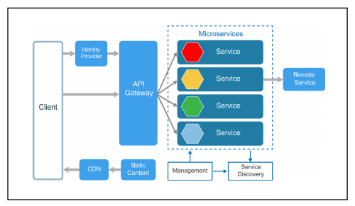
Microservices?
“The microservice architecture enables the rapid, frequent and reliable delivery of large, complex applications. It also enables an organization to evolve its technology stack.”

Slide 6
1. use microservices when not needed
You have Microservices Envy, chose because it’s a “fashionable” architecture choice https://www.thoughtworks.com/radar/techniques/microservice-envy
Notes:
Google is doing it
Seems cool

Slide 7
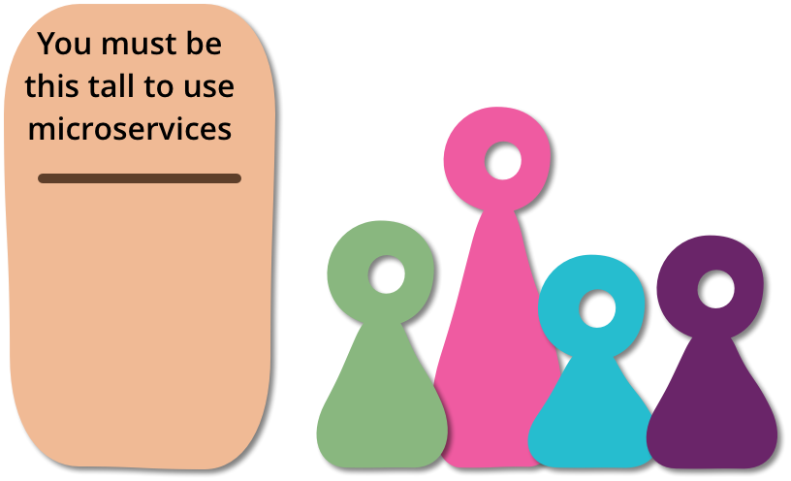
You must be this tall to ride
Microservices add a lot of complexity As Martin Fowler, one of the most influential thinkers in modern software development, states, "...don't even consider microservices unless you have a system that's too complex to manage as a monolith..."
Notes:
Adds overhead
design, interoperability of services, management, system resources, deployment, support
Adds complexity
Can become fragile
can become "fragile" if done incorrectly

Slide 8
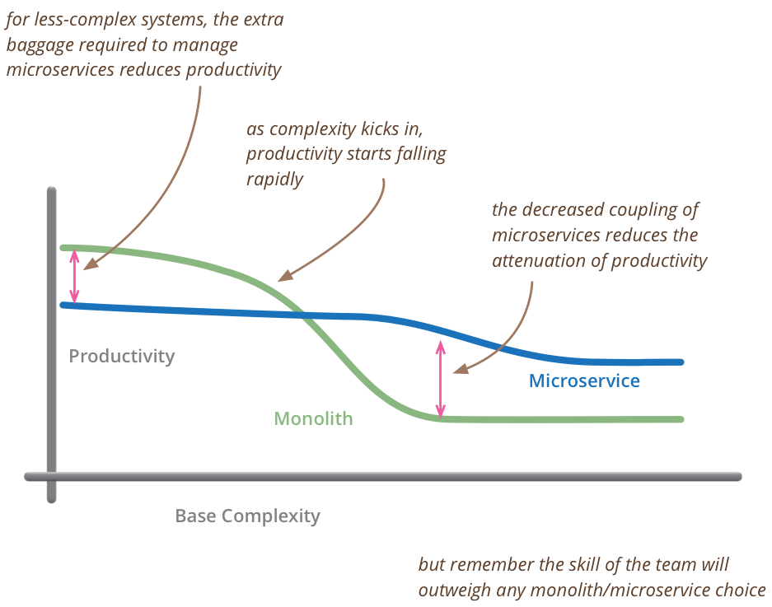
Complexity can slow productivity

Slide 9
When not needed?
Small team
Low release velocity
Low code churn – existing app just works
Culture or team is not ready
Notes:
Less than a 2 pizza team? May not be needed
If you are releasing once a month or less and do not plan on increasing that? You may not achieve many benefits. Velocity is a major advantages of microserices
Low code churn. Things just work and users are not asking for additional features
Distributed computing requires a bit of a culture shift. Your clients may now be other developers vs the end user.
You may not own the entire stack anymore

Slide 10
2. Testing is for losers
Small changes cause cascading failures
Others now depend on your service
Notes:
A change you make to a response or request may get passed through other services and break a service you didn’t even know used it
Adding a new field, returning an array instead of string for instance, can break other services or applications that rely on your service

Slide 11


Slide 12
testing
Use contract-based testing
Integration tests when possible
Unit tests should be enforced in deployment pipeline
Notes:
You are building for others. Don’t break their applications
Contract-based testing runs your application and checks that it works for a given know set of parameters, it returns a known set of outputs
Integration tests: when possible, ensure system works together; beyond a certain point, this can become untenable
Should be automated, enforced. Unit tests that do not prevent check-ins when they break are useless
Without proper tests, likely have a very fragile system, small changes that are seemingly inconsequential can break other parts of the system in unforsceen ways
Use contact-based testing, ensures consistency across system boundaries

Slide 13

Test in production
Implement red-green deployments
Use feature flags
Enable easy rollback

Slide 14

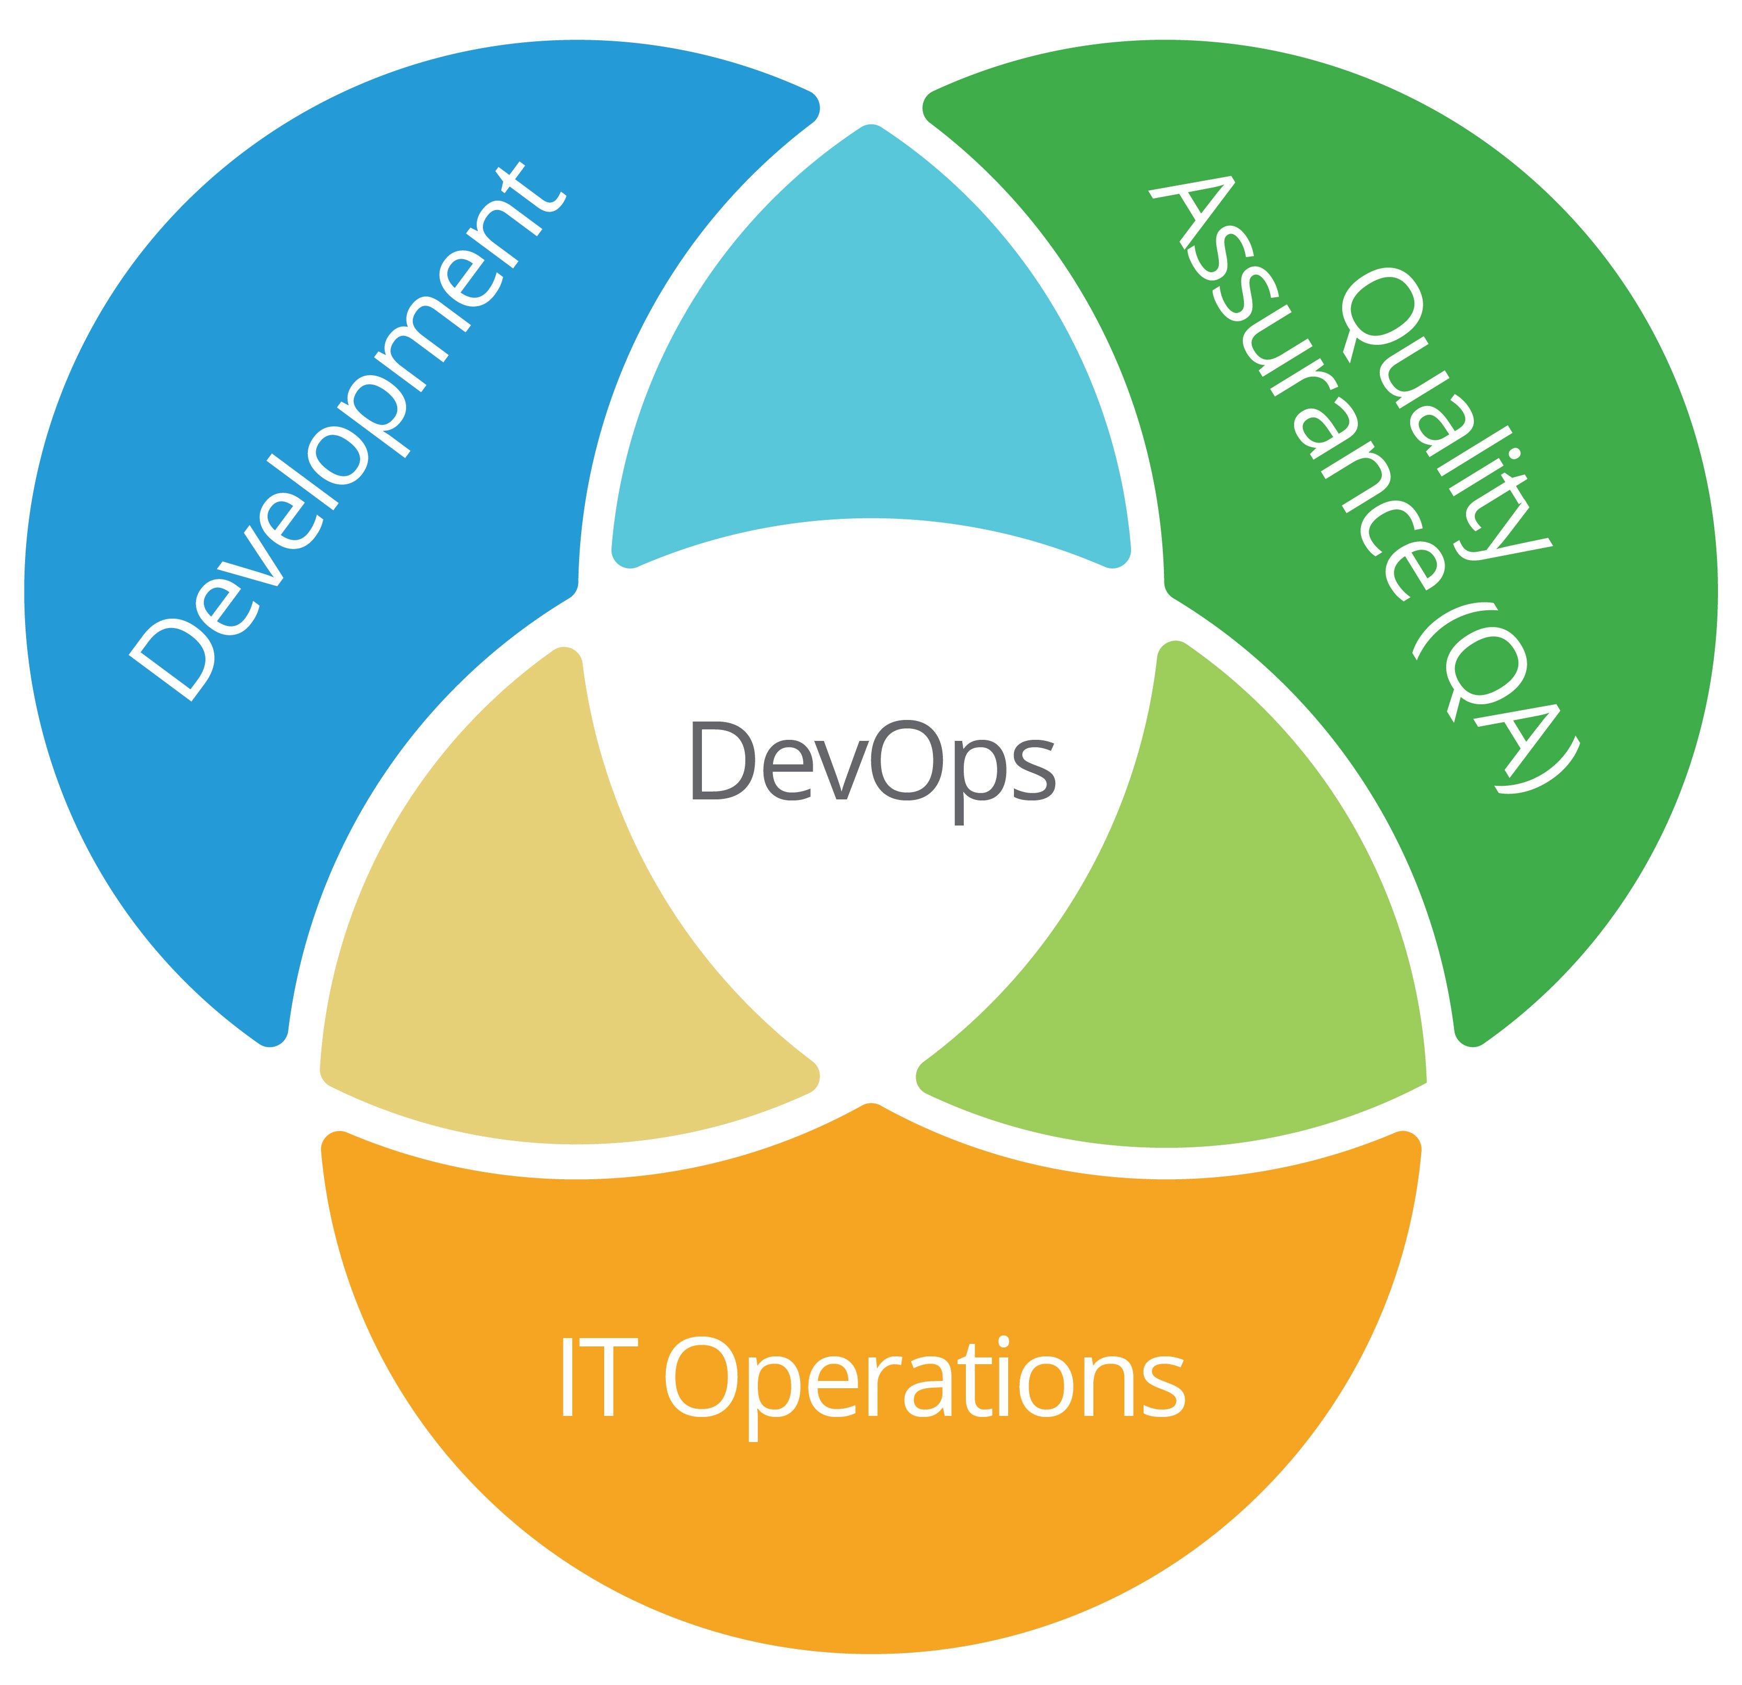
3. We don’t need devops!

Slide 15
Logging and tracing
Difficult finding where errors occur
Where is the slow response time occurring?
what services were called when the failure occurred?
Use Centralized logging and distributed tracing
Notes:
Wading through several different systems trying to determine which services were called when the error occurred,
Logging: reports errors and information about requests
Distributed tracing

Slide 16
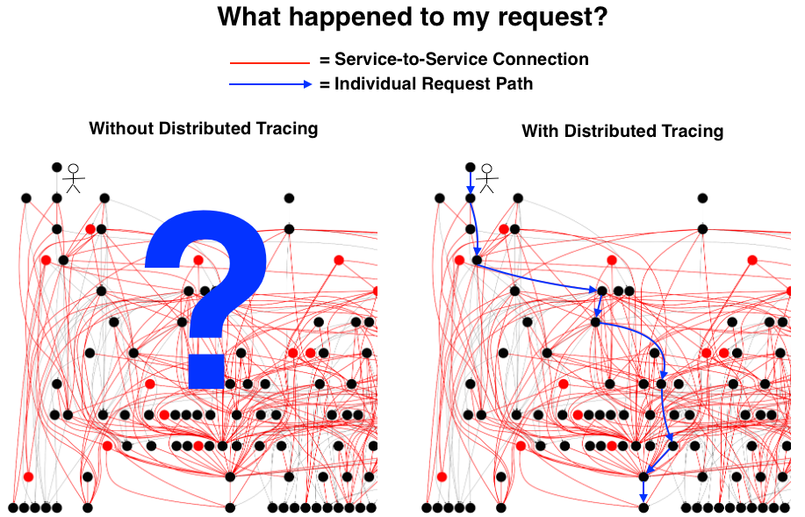
Notes:
Distributed tracing example

Slide 17
Automated deployments
Deploying a new environment can be very complex
Manual deploys are error-prone, time consuming and painful

Slide 18
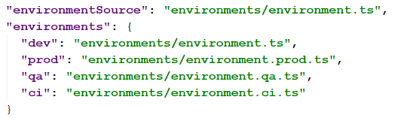
Configuration management
"Google’s site reliability team has found that roughly 70% of the outages are caused by changes in a live system." - https://medium.com/@justinamiller_1857/building-reliable-microservices-62db20dec674

Slide 19
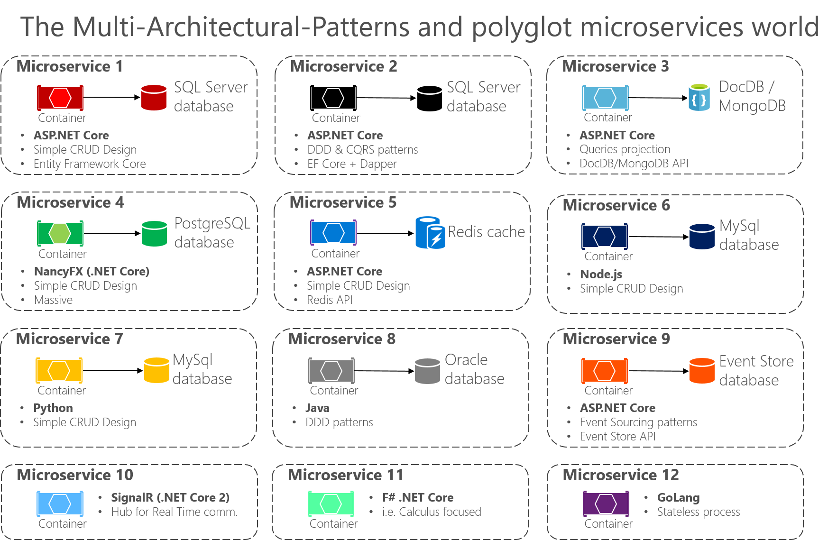
4. Polyglot all the way
Choose appropriate technology for the task
Notes:
Sounds great, right? You can pick the correct language perfectly fit for the given problem.

Slide 20
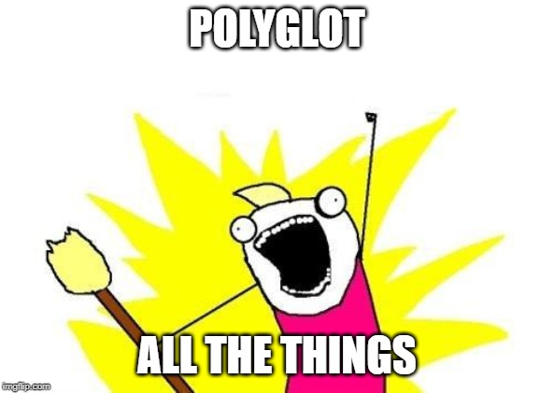
All the things!
Limits movement between teams
Makes support extremely difficult
Devops?
Standards and best practices?
Expensive!
Notes:
people get moved across teams, they will need to learn a new language, or program the new language as if it was the old language. There are a lot of different standards, best practices, base libraries and such to get up to speed with
Re-engineering lots of common patterns, lots of burnt fingers, best practices, lessons learned, etc need to redo
Need to know corner cases and differing functionality between systems
Can get quite expensive: keeping resources for each language, re-writing the same code, knowing how to deploy, run, diagnose, scale, maintain each

Slide 21

Stick to single tech stack
A single tech stack is ok!
Notes:
Stick to a single tech stack unless there is a overwhelming reason not to

Slide 22
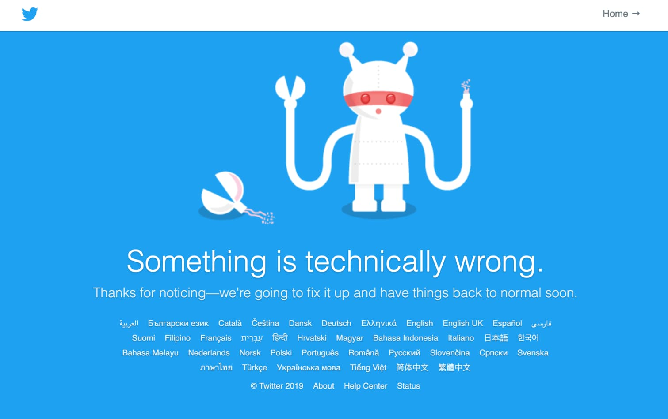
5. Don’t expect failures
Network calls unreliable
Fragile and unstable
Cascading failures
Notes:
Distributed systems, calls over network. Network is much less reliable than calls in memory, and they will fail. Systems will break, and they will fail. Calls may fail during deploys
Not architecting for resiliently will cause the system to be extremely fragile, failing often. You can keep fixing the “bugs”, but unless you change architecture, it will not help stability
Cascading failures

Slide 23
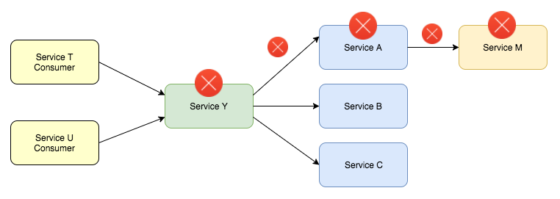

Whack-a-mole
Notes:
Errors happen.
As amount of microservices increases, failures can increase exponentially

Slide 24
Build for resiliency
Graceful degradation
Health checks
Retry commands
Idempotent
Circuit breakers
Test for failure
Notes:
Try graceful service degradation:
Logging services or metrics stop responding, should we break the entire app?
Can we return cached, or stale, or generic information to the user instead of failing?
Can we not load a single component on the page instead of Erroring out the entire page
Use health checks, stop sending data to unhealthy instances
Retry commands for transient errors (with exponential backoff to prevent flooding the service if it goes offline and suddenly comes back online)
Idempotency is important for transactions that cannot be run multiple times
bulkhead stop sending to a failed service for a period of time if all requests are failing (limits failure)
Circuit breakers instead of timeouts: protect resources to help them recover: stop flowing traffic if an error occurs multiple times in a short period

Slide 25
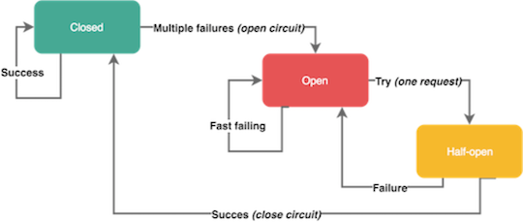
Circuit breakers

Slide 26
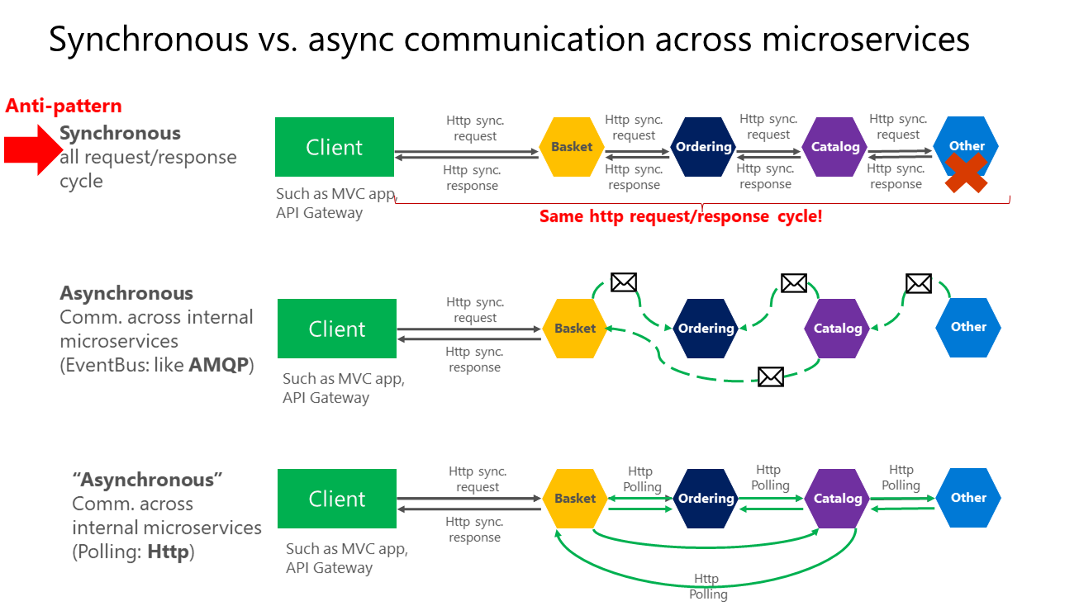
Process asynchronously
Notes:
Use queues to process asynchronous jobs
Load-levelling, services will not get overloaded when there are spikes or they get really busy. Transactions will queue and eventually catch up.

Slide 27
6. ignore change strategy
Contracts are not set in stone
My code works!
Figure it out after production
Notes:
Changes include any change to the data contract both inputs and expected outputs
could be field name change, adding a new required field, changing a string to an array, etc
Remember, your contracts change.
You may make changes to your code, and things look right on your side, but a consumer may break

Slide 28
Change strategies
Make calls backwards compatible
Version endpoints
Hide changing at api gateway
Test changes and communication during development
Notes:
When possible, attempt to make your api backwards compatible
You can version endpoints, either in url or http header
Hide changes from consumers by handling it in the api gateway. Api gateway sits in front of your service and performs cross cutting concerns, load balancing, etc. but can also transform requests and responses between services

Slide 29
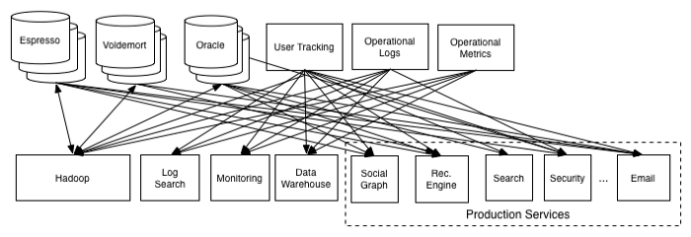
7. Tightly couple microservices
Cross-service calls
Notes:
Lots of cross-service calls
Avoid synchronous calls
Use event bus for cross-service work
Event-driven architecture, stateless design
This is a linked in architecture before they moved to a event bus architecture with kafka

Slide 30
Limit shared code – OMG!
Causes upgrade issues
Leverage api gateway for cross cutting concerns where possible
Notes:
security/authorization, logging, data transformations, etc
Service discovery
Load balancing
Retries, circuit breaker
Response caching
Tracing/correlation/logging
Rate limiting

Slide 31
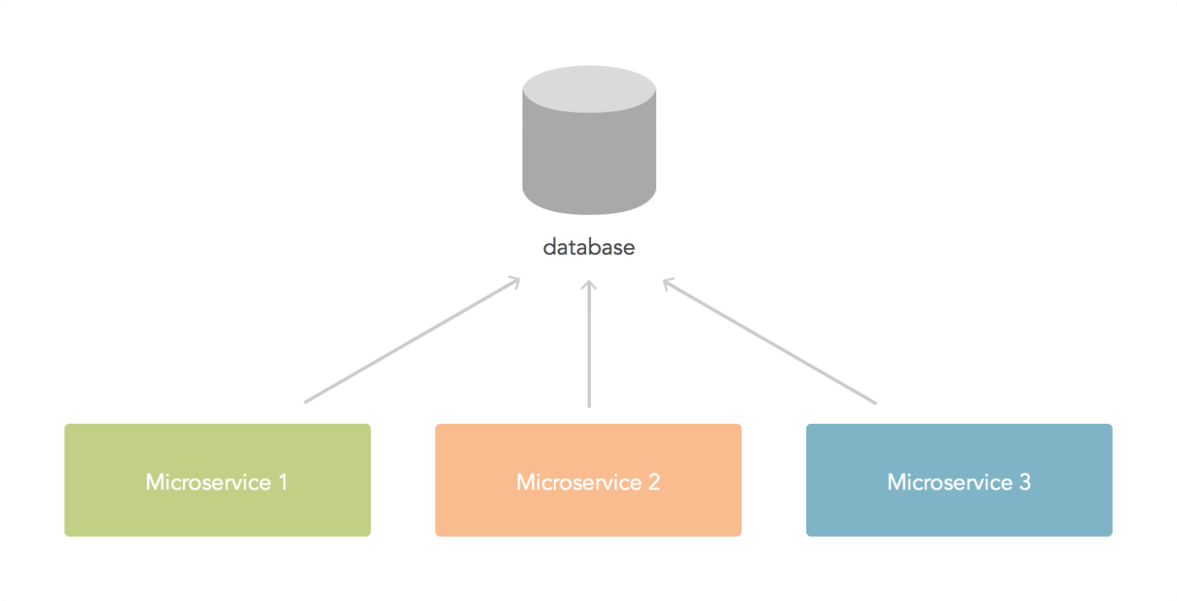
Don’t share database
Changing schema difficult
Coordination
Who is using what?
Deployment challenges
Notes:
Very tied together now:
Changing schema a real problem: Change a field name, remove a field, add a field, break other application
Need to coordinate all changes with all groups
May not even know who is using the data, much less which data in the database they are using
May not find out something is broke until deployment
Share with event bus

Slide 32
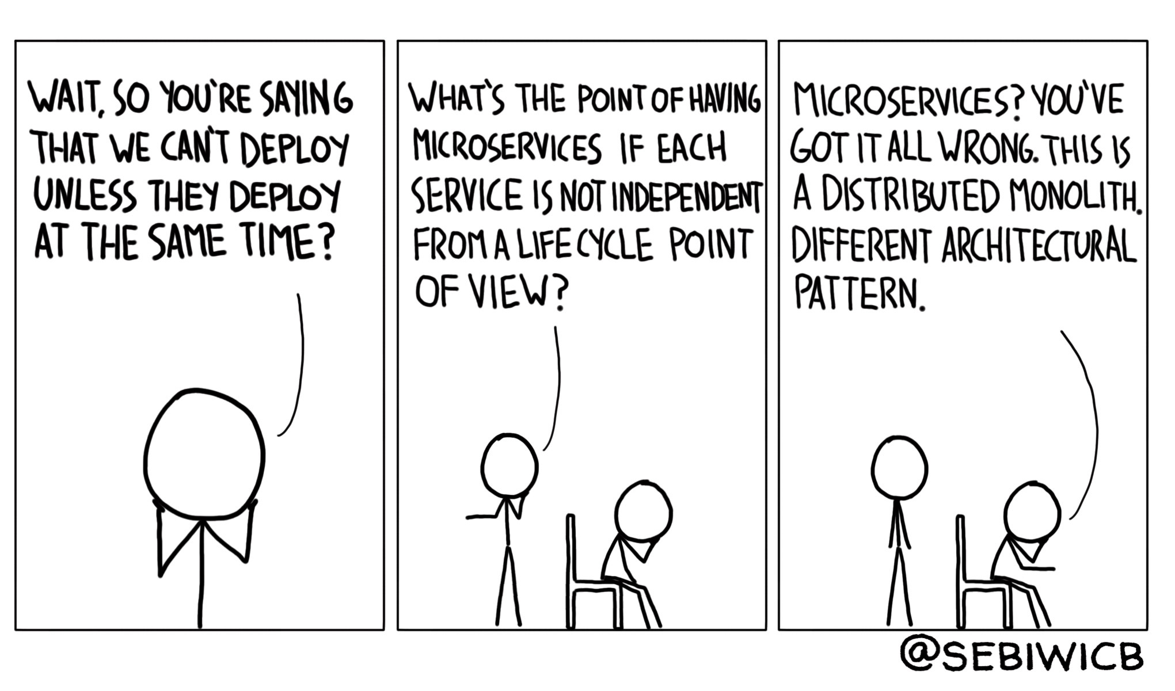
Prevent distributed monolith
Physically distributed services that are inter-dependent
Cannot independently deploy
No encapsulation
Worst of both worlds
Notes:
Creates a distributed monolith, disadvantages of both microservices and a monolith application “So, if we follow that course of logic, then what would a distributed monolith be? Well, it would be a set of physically distributed services that are intertwined. Sound familiar? I hope for your benefit, it isn’t too familiar.”
Very complex
Cannot independently deploy services
No encapsulation
Worst of both words
A change to one microservices requires changes to others
Microservices are very chatty
Several services need to be deployed at the same time

Slide 33
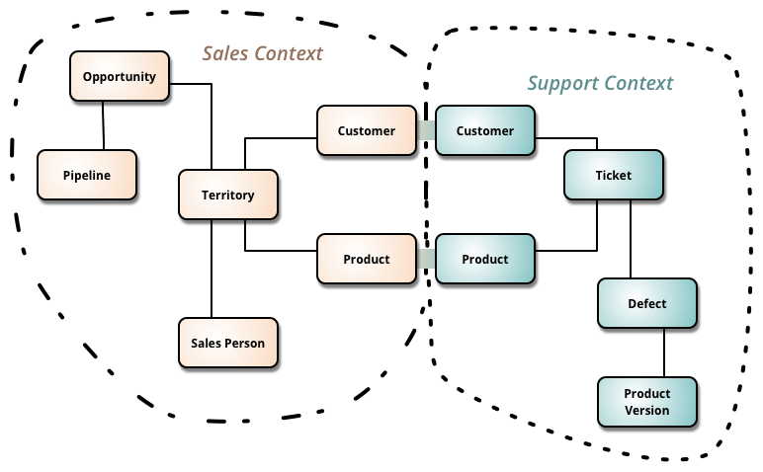
Bounded context
Notes:
Domain driven design: bounded context: only knows about its one data and actions

Slide 34
Review
Use Microservices when not needed
Testing is for losers
We don’t need Devops!
Polyglot all the way
Don’t expect failures
Ignore change strategy
Tightly couple microservices

Slide 35

Questions?

Slide 36
Thank you!
mike@redpillconsulting.io
https://www.linkedin.com/in/michaelacord/
Resources:
https://thenewstack.io/succeed-failure-microservices/
https://medium.com/@ygrenzinger/you-need-to-be-this-tall-to-go-from-monolith-to-microservices-part-1-be0835ff380b
https://www.youtube.com/watch?v=X0tjziAQfNQ
https://dzone.com/articles/getting-off-the-microservices-bandwagon
https://dzone.com/articles/top-5-microservices-architecture-and-design-best-p
https://www.thoughtworks.com/insights/blog/domain-driven-design-services-architecture
https://codingsans.com/blog/microservice-architecture-best-practices
https://www.marutitech.com/microservices-best-practices/
https://www.solutionsiq.com/resource/blog-post/microservices-done-right-avoid-the-antipatterns-part-1/

Slide 37


